Slide 1
Business Intelligence G. Mudare

Slide 2
Special data types

Slide 3
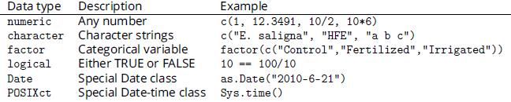
Special data types
A dataframe can contain six types of data. These are summarized in the table below:
R has a very useful built-in data type to represent missing values. This is represented by NA (Not Available)

Slide 4
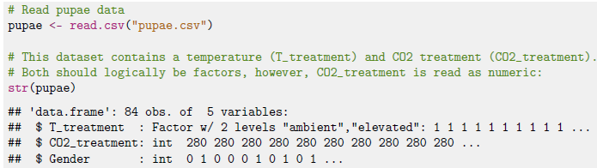
Working with factors
The factor data type is used to represent qualitative, categorical data.
When reading data from file, for example with read.csv, R will automatically convert any variable to a factor if it is unable to convert it to a numeric variable.
You can use as.factor to convert it to a factor if its already numeric

Slide 5
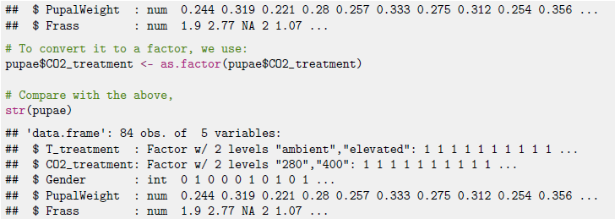
Working with factors

Slide 6


Working with factors
A factor variable has a number of ’levels’, which are the text values that the variable has in the dataset.
This Shows the three unique species in this dataset
We can count the number of rows in the dataframe for each species

Slide 7
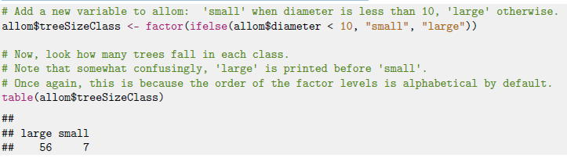
Working with factors
when the dataframe is read, the levels are assigned based on alphabetical order(Often, not very logical)
We can generate new factors, and add them to the dataframe

Slide 8
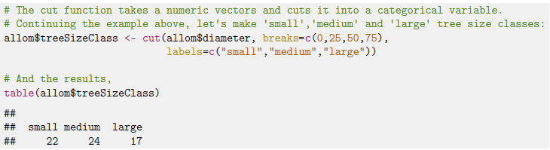
Working with factors
to add a new factor based on a numeric variable with more than two levels:

Slide 9
Working with factors
To add a new factor based on a numeric variable with more than two levels:

Slide 10
Empty factor levels
Each unique value of a factor variable is assigned a level, which is used every time you summarize your data by the factor variable.
Even when you delete data, the original factor level is still present
Sometimes it is more convenient to drop empty factor levels with the drop levels function.

Slide 11
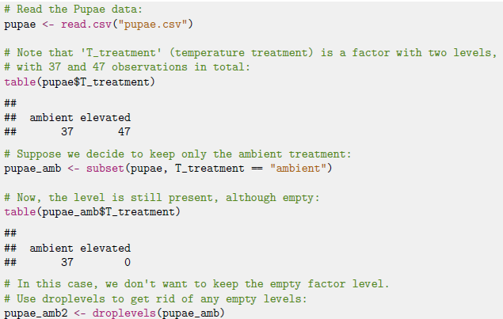
Empty factor levels

Slide 12

Changing the levels of a factor
If you want to change the levels of a factor, to replace abbreviations with more readable labels.
To do this, you can assign new values with the levels function,

Slide 13
Working with logical data
Some data can only take two values: true, or false.
R has the logical data type.
Logical data are coded by integer numbers (0 = FALSE, 1= TRUE]

Slide 14
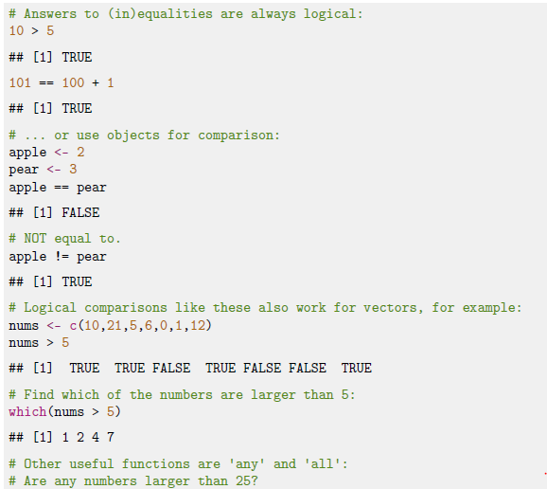
Working with logical data

Slide 15
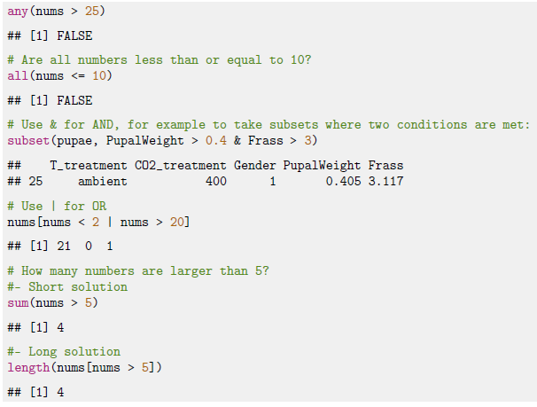
Working with logical data

